Slide 1

A PREDICTIVE LOOK: CUSTOMER
SATISFACTION OF LONDON-BASED
AIRBNB RENTALS
Group 5 – Helen Ayenew, Morris Flater, Scott Blackburn

Slide 2
BUSINESS OBJECTIVE
Airbnb is a successful means of renting out rooms, houses or living quarters. Oftentimes, these properties are purchased with the intent of capitalizing on the property. In order to get the highest price for the listing, Airbnb listers need to maintain an “excellent” satisfaction rating. We analyze thousands of properties listed by Airbnb in London England on weekends to help predict customer satisfaction using a number of predictor variables. Our goal is to use these predictor variables to see how they contribute to an “excellent” satisfaction rating of 95 or greater so we can inform potential Airbnb listers to help guide their purchasing decisions.
In order to aid a potential London-based property owner, we must be able to answer some basic questions.
Which variables most contribute to the satisfaction of the customers?
Which variables do not contribute to the satisfaction of the customers?
How does the price paid correlate with the satisfaction of the customer?

Slide 3
DATA
The Airbnb Price Determinants in Europe include numerous datasets of Airbnb rentals for European cities. Each city’s dataset contains features on different properties and their impacts on the cost. The team will examine the Airbnb pricing dataset from London, which has details about the price of the property, the number and type of bedrooms, whether the host is a super-host or not, the distance of the Airbnb from the city center and the closest metro station, and much more. The London dataset includes 5,378 observations, each representing unique rental data. However, to meet the project criteria, the team will reduce the number of observations to 1,500, by generating random variables using Analytic Solver. The dataset that will be used have a total of fifteen attributes, of which twelve are numerical, and three are categorical.

Slide 4
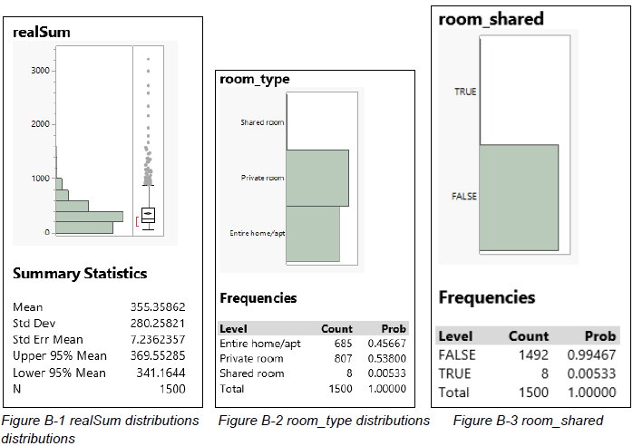
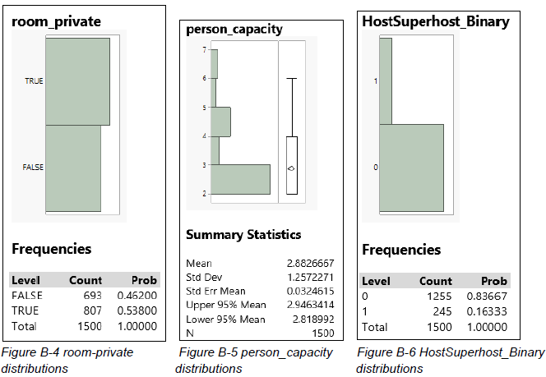
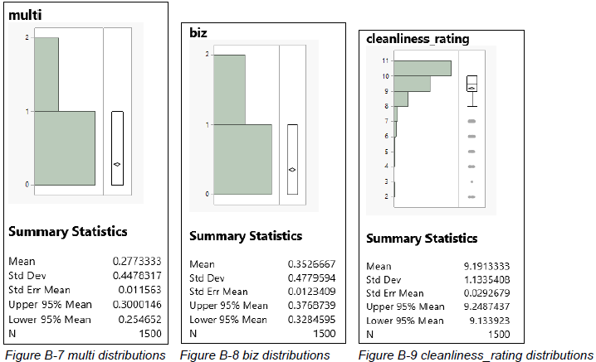
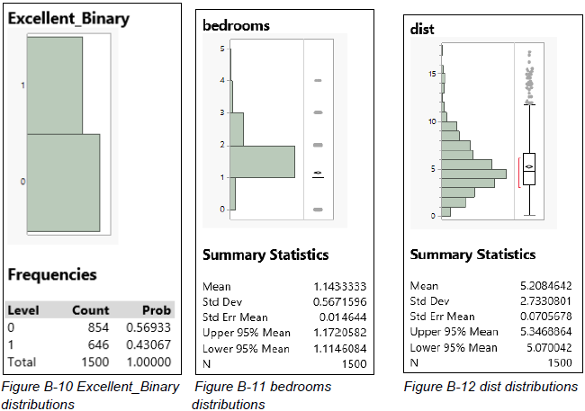
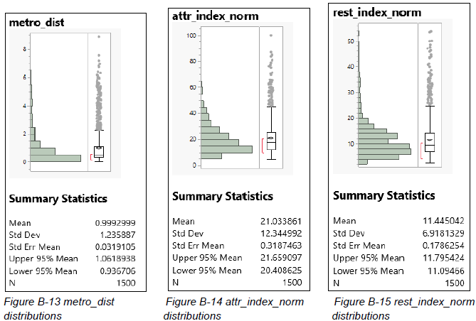

DATA

Slide 5
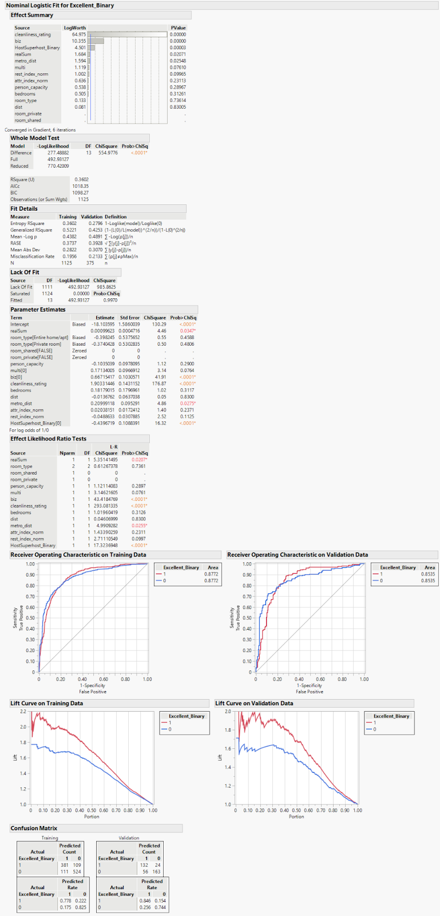
LOGISTIC REGRESSION
The initial model included fourteen variables, five of which were categorical variables and nine of which were numerical variables.
The Fit Details for the Validation data of this model are a RSquare of 0.4253, RASE of 0.3928, Misclassification Rate of 0.2133 and an AICc of 1018.35. As an additional measure of fit, we noted the Receiver Operating Characteristic (ROC) index for the validation set was a healthy 0.8535, indicating a high goodness-of-fit.

Slide 6
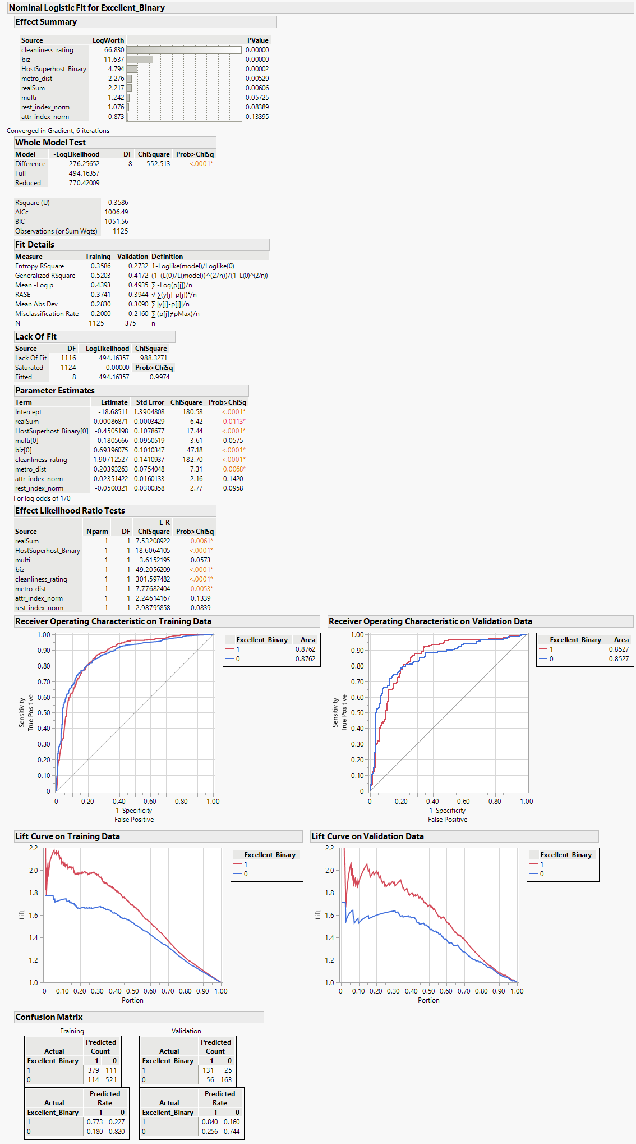
STEPWISE REGRESSION
We then ran Stepwise Regression in an attempt to improve the quality of the model, which resulted in the number of variables being reduced to eight numerical variables. The Fit Details for the Validation data of this model are an RSquare of 0.4172, RASE of 0.3944, Misclassification Rate of 0.2160, and an AICc of 1006.49. The ROC index was comparable to that of the initial logistic model at 0.8527.

Slide 7
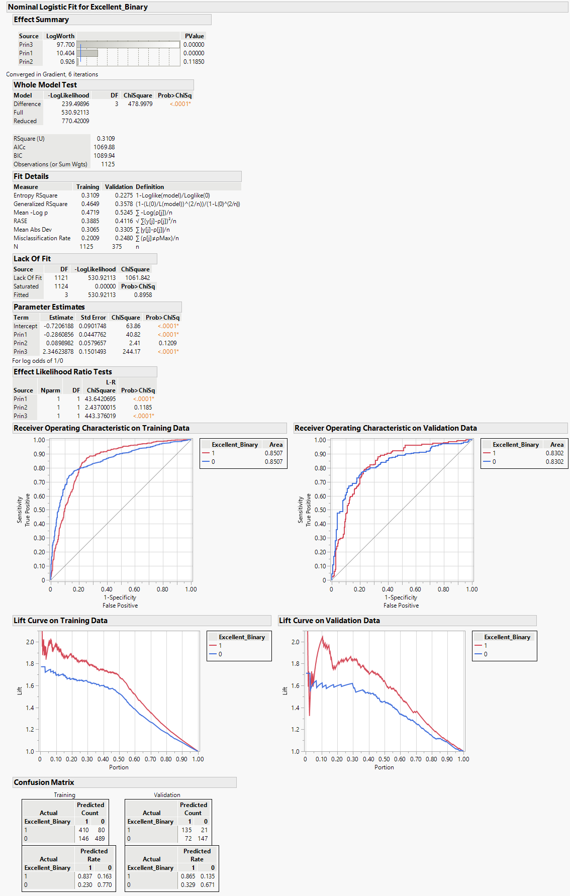
PRINCIPAL COMPONENT ANALYSIS (PCA)
The next technique that we explored was Principal Components Analysis. We chose to use three Principal Components that had Eigenvalues of 3.3456, 1.8881, and 1.0112, respectively, and a Cumulative Percent of 78.061. We then ran Logistics Regression using the three Principal Components and the Fit Details for the Validation data for this model are an RSquare of 0.3578, RASE of 0.4116, Misclassification Rate of 0.2480, and an AICc of 1069.88. The ROC for this model fell slightly to 0.8302.

Slide 8
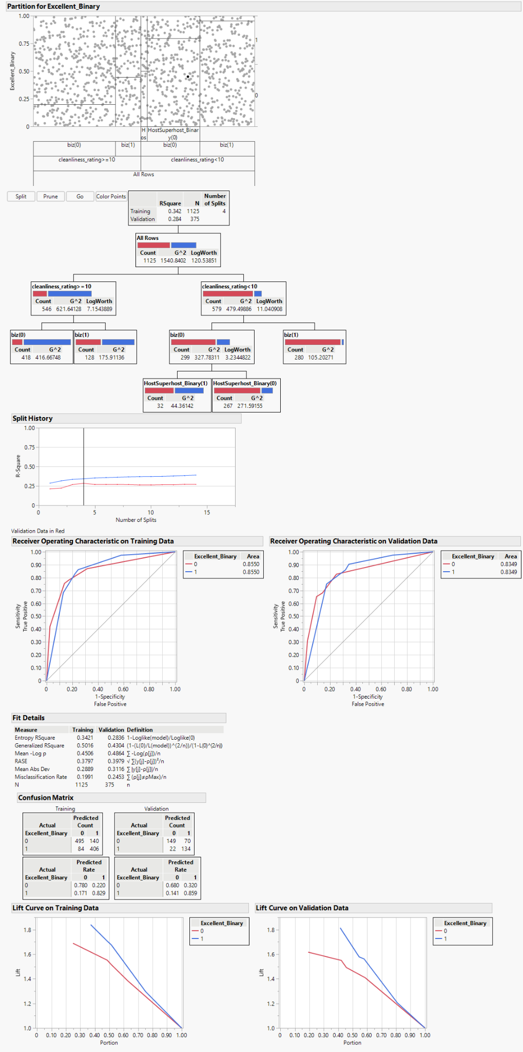
DECISIONS TREES
The next technique that we considered was Decision Trees. The optimal number of splits was determined to be four with the initial split using the ‘cleanliness_rating’ and whether or not this was >=10 or <10. The next split was on the ‘biz’ variable and then the ‘HostSuperhost_Binary’ variable. The Fit Details for the Validation data for this model are an RSquare of 0.4304, RASE of 0.3979, and a Misclassification Rate of 0.2453. The RSquare was slightly higher than the original model as was the RASE and Misclassification Rate. The ROC Index was 0.8349 which lies slightly below the initial logistic model.

Slide 9
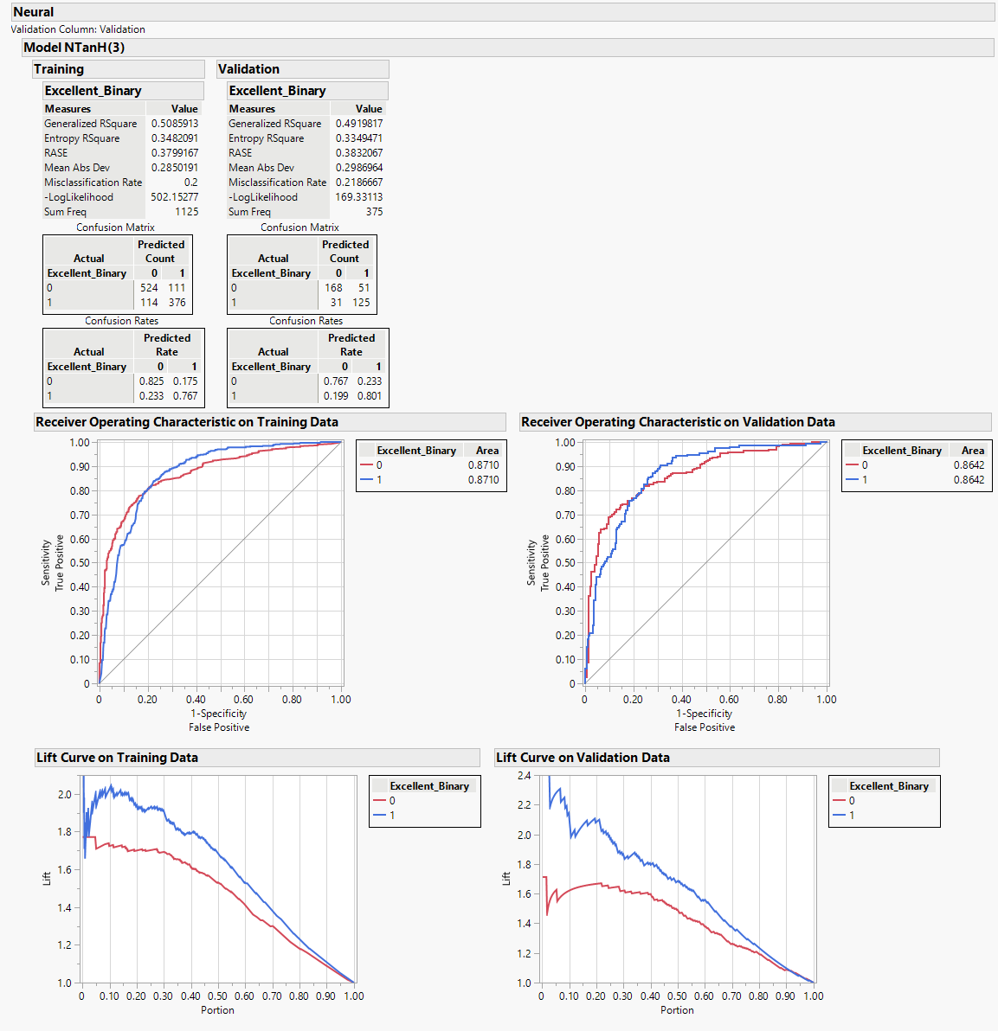
NEURAL NETWORK
We ran a series of Neural analysis setting the Number of Tours to 1, 30, 50, and 100. We determined that 50 tours represented the optimal results and the Fit Details for the Validation data for this model are an RSquare of 0.4920, RASE of 0.3832, and a Misclassification Rate of 0.2187. The ROC index of the Neural model rose to 0.8642 which lies above all other models further indicating it may be the best model for this data set.

Slide 10
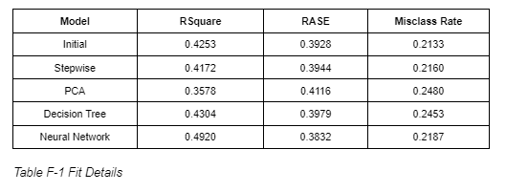
CONCLUSION
A high RSquare indicates a satisfactory fit. The closer its value to 1, the better the classification and model. However, a small value of Misclassification Rate and RASE implies a better fit and prediction.
As seen in Table 1, the Neural Network model has highest RSquare of 0.4920, the lowest RASE of 0.3832, and the third lowest Misclassification Rate of 0.2187, making it the best model for our dataset.
We decided a significantly higher RSquare of the Neural Network model outweighed its slightly higher Miscalculation Rate than the Initial and Stepwise models.

